Slide 1
H2 Corridor
Appendix: Piping deltap calculation by ChemCad
2025 1112
Dr. Yoshitsugi Kikkawa

Slide 2
Slide 1: Abstract
• Concept: Kongiganak–to–Chicago H₂ corridor with EHC booster stations.
• Supply: Alaska wind + Southwest solar powering PEM electrolyzers.
• Operations: 350→330 bar per reach; re‑boost to 350 bar at each EHC.
• Self‑power: small PEM fuel cells at stations using tiny H₂ taps.
• Outcome: scalable, resilient backbone enabling deep decarbonization.

Slide 3
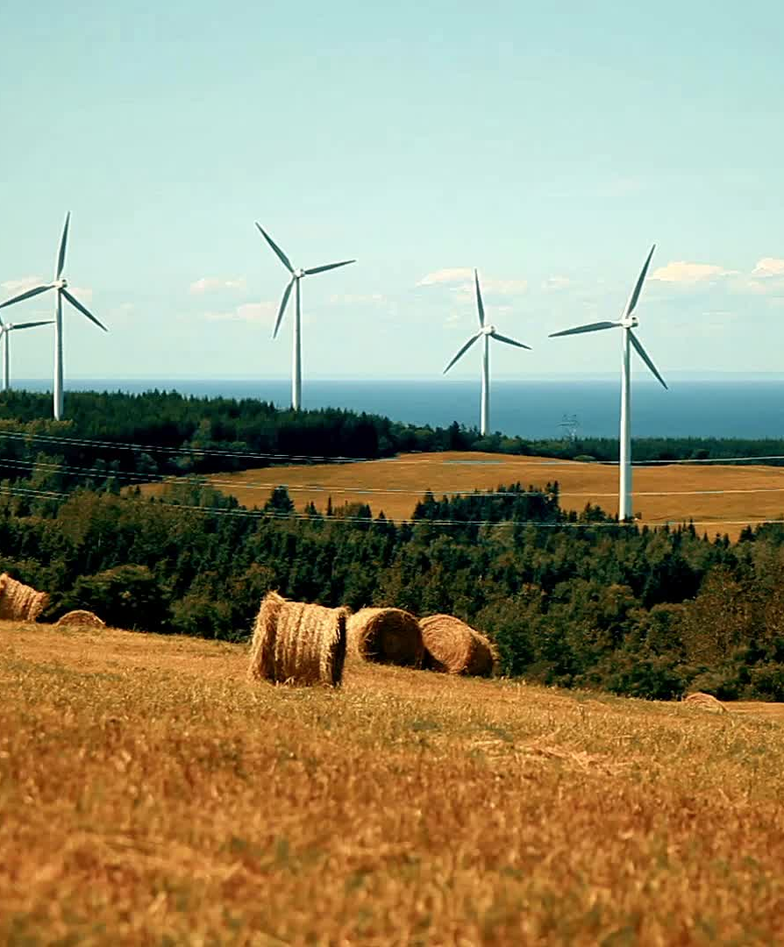
Slide 2: Green Hydrogen will Stop the Global Warming
• Replace fossil fuels in hard‑to‑abate sectors with clean H₂.
• Leverage abundant wind in Alaska and solar in U.S. Southwest.
• Move dense, high‑pressure H₂ via a continent‑scale pipeline corridor.
• Deliver quiet, zero‑emission energy to cities, industry, and mobility.
• Target material CO₂ cuts on a pathway toward pre‑industrial 280 ppm.

Slide 4
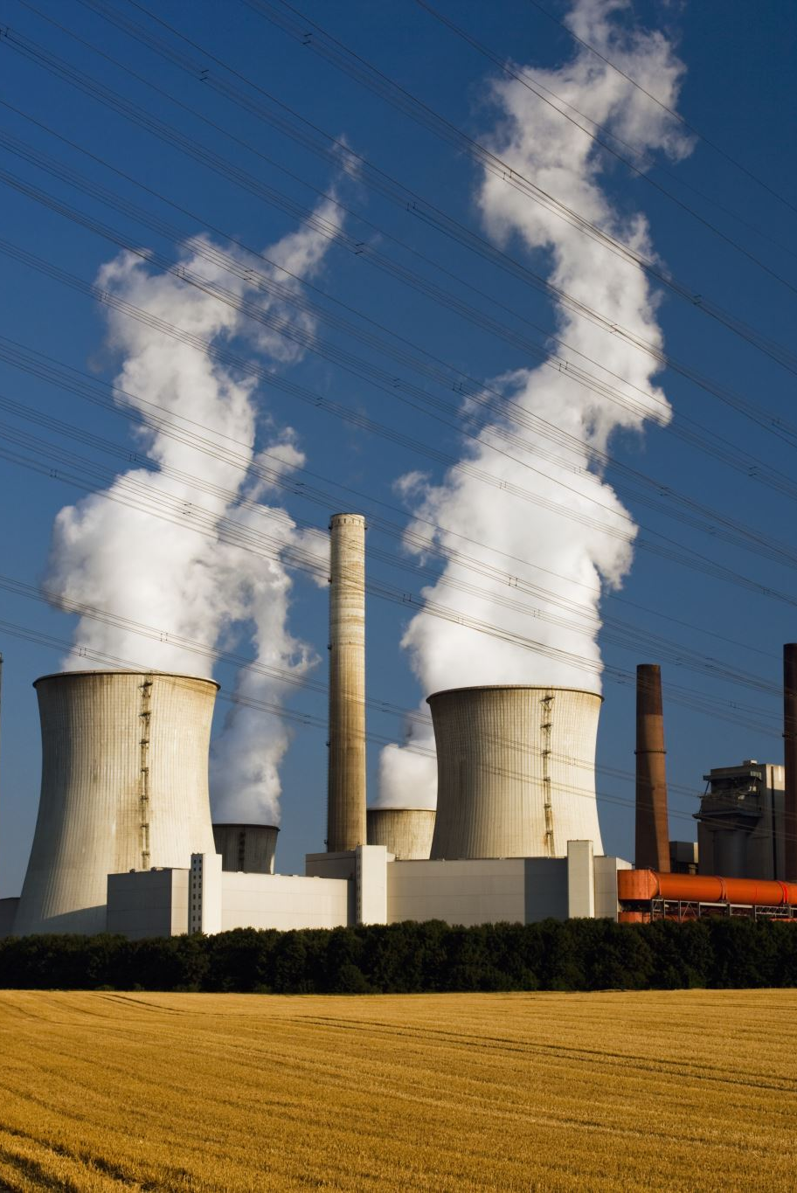
Slide 3: What is the Problem We Are Facing?
• Global warming persists despite rapid renewable deployment.
• Heavy industry, freight, and backup power still burn hydrocarbons.
• Electric grids alone struggle with seasonal and long‑distance balancing.
• Hydrogen offers storable, transportable, cross‑sector clean energy.
• We need an efficient, continental H₂ logistics system now.

Slide 5
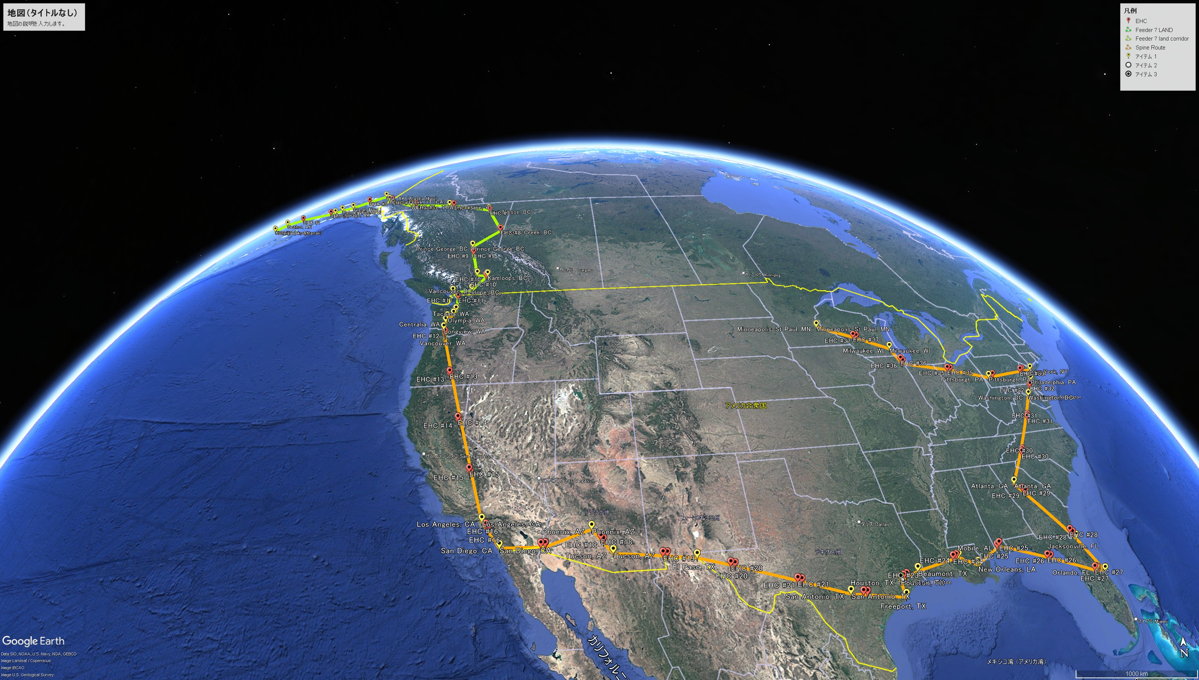
Kongiganak as “Supply Hub #1 – Alaska Wind (CF 58.95%)”
This reinforces credibility in the corridor origin.
Slide 4A: H2 Corridor from Alaska to St.Paul/Minneapolis, "Spine Version" (ends at St. Paul/Minneapolis)
• Route: Kongiganak → Seattle → Portland → Los Angeles → San Diego → Yuma → Phoenix → Tucson → El Paso → San Antonio → Freeport → Houston → Beaumont → Baton Rouge → New Orleans → Mobile → Orlando → Cape Canaveral → Jacksonville → Atlanta → Washington, DC → Philadelphia → New York → Pittsburgh → Chicago, Milwaukee, St.Paul/Minneapolis
• Pipe: API 5LX X52, 54‑in OD, 150‑mm wall (incl. 3‑mm CA).
Kongiganak as “Supply Hub #1 – Alaska Wind (CF 58.95%)” This reinforces credibility in the corridor origin.
• Operating envelope: station start 350 bar → segment end 330 bar.
• Station spacing: ~300–400 km; N=20/30/40 variants studied.
• Taps deliver city/industrial supply with pressure reduction skids.

Slide 6
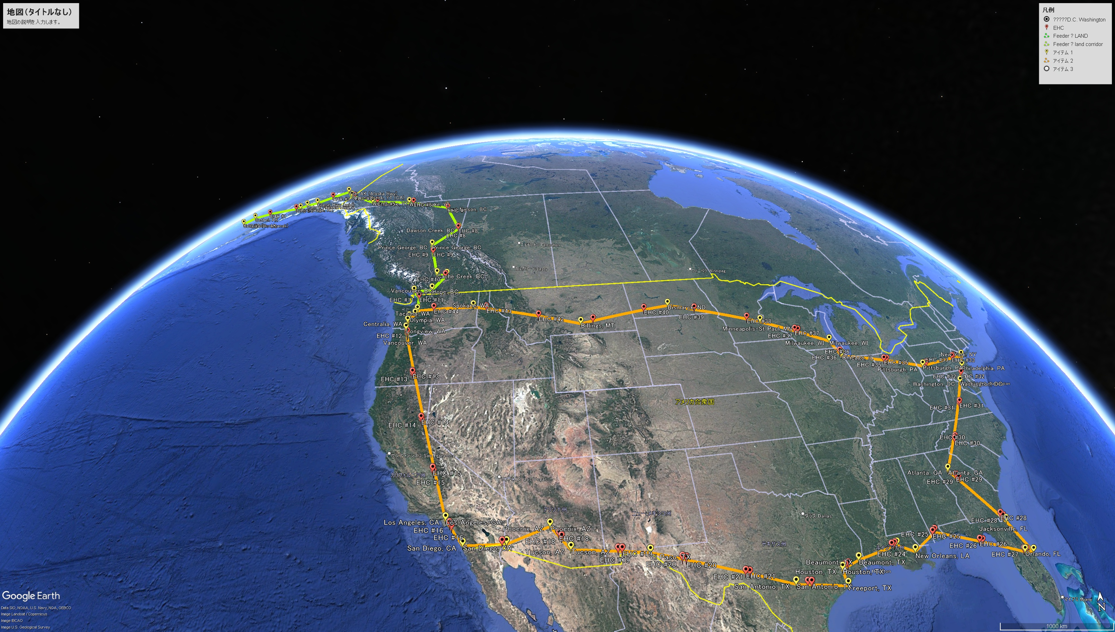
Kongiganak as “Supply Hub #1 – Alaska Wind (CF 58.95%)”
This reinforces credibility in the corridor origin.
Slide 4B: H2 Corridor Ring from Alaska to St.Paul/Minneapolis, Seatle "Ring Version" (returns through Bismarck/Billings back to Seattle)
• Route: Kongiganak → Seattle → Portland → Los Angeles → San Diego → Yuma → Phoenix → Tucson → El Paso → San Antonio → Freeport → Houston → Beaumont → Baton Rouge → New Orleans → Mobile → Orlando → Cape Canaveral → Jacksonville → Atlanta → Washington, DC → Philadelphia → New York → Pittsburgh → Chicago, Milwaukee, St.Paul/Minneapolis, Seatle
• Pipe: API 5LX X52, 54‑in OD, 150‑mm wall (incl. 3‑mm CA).
Kongiganak as “Supply Hub #1 – Alaska Wind (CF 58.95%)” This reinforces credibility in the corridor origin.
• Operating envelope: station start 350 bar → segment end 330 bar
• Operating envelope: station start 350 bar → segment end 330 bar.
• Station spacing: ~300–400 km; N=20/30/40 variants studied.
• Taps deliver city/industrial supply with pressure reduction skids.

Slide 7
Slide 5: Proposed System Configuration
• PEM electrolyzers at Alaska and Southwest desert hub(s).
• Electrochemical hydrogen compressors (EHCs) at each station.
• PEM fuel‑cell skids power stations from corridor H₂ taps.
• PRS skids provide 30–80 bar delivery to customers. rEHC used as expander to recover the power by rEHC (rEHC = regenerative electrochemical hydrogen compressor used as an expander for pressure-energy recovery at PRS)
• Optional buffers: line‑pack, cavern storage, high‑pressure tanks.

Slide 8

Slide 6: Hydrogen Transportation Cost (LOHC vs Pipeline)
• LOHC adds hydrogenation/dehydrogenation energy and complexity.
• Marine logistics suit LOHC, but adds recurring conversion losses.
• Pipelines excel at continuous, high‑volume, long‑distance transport.
• CAPEX is higher upfront; OPEX and unit costs fall with throughput.
• For continental scale, pipelines beat LOHC on delivered $/kg.

Slide 9
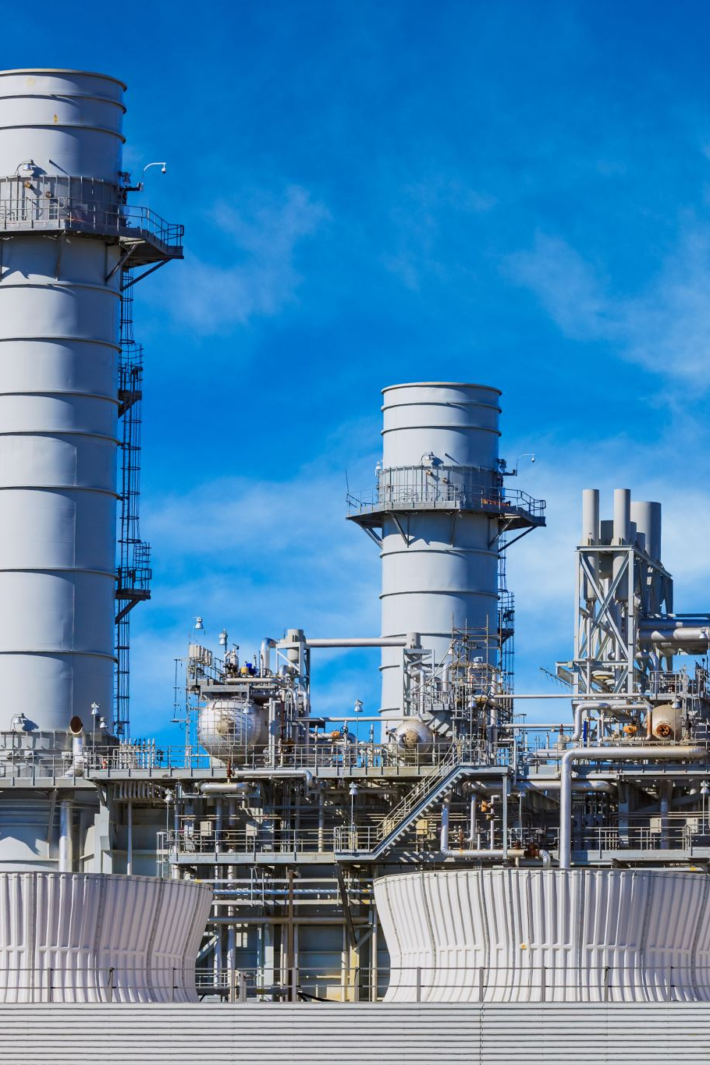
Slide 7: Electrochemical Hydrogen Compressor vs Mechanical Compressor
• EHC: solid‑state, no moving parts; low noise, high reliability.
• Higher isothermal efficiency vs. heat‑limited mechanical trains.
• Modular skids scale per station load; simplified maintenance.
• Avoids oil contamination and seal wear issues.
• Result: lower lifecycle cost and better station availability.

Slide 10

Slide 8: Global Hydrogen Production by 2050
• Hydrogen demand rises across industry, transport, and power.
• Corridors unlock regional resources for distant consumers.
• Alaska wind + desert solar position U.S. as H₂ exporter.
• Pipelines become the backbone of clean‑molecule trade.
• Early corridors de‑risk the 2030s–2040s scale‑up.

Slide 11
Slide 9: Hydrogen Cost at Tap Point
• Dominant driver is renewable electricity price and CF.
• EHC and PRS efficiency protect delivered $/kg.
• Large line throughput spreads fixed costs per kg.
• On‑site FC self‑power avoids HVDC capex and losses.
• Target competitive with U.S. grey/blue H₂ benchmarks.

Slide 12

Slide 10: Hydrogen Storage
• Short‑term: Type IV tanks for mobility (FCV) depots and PRS buffers.
• Medium‑term: pipeline line‑pack increases with pressure swing.
• Seasonal: salt caverns where geology permits; rEHC/EHC for cycling.
• Absent caverns: high‑pressure pipe‑blocks at solar hubs.
• Choose storage by duty: response time, volume, and cost.
Note: Alternatively 38/40/42 inch OD with 150mm wall thickness, 785/745/710Bar MOP pipe block can be applied, via rEHC/EHC device.

Slide 13

Slide 11: Renewable Energy Mix, Wind Turbine and Solar PV
• Kongiganak wind: strong capacity factor, 58.95%; winter/night complement.
• SW desert PV: high insolation; summer/day complement. capacity factor, 28%;
• Diversity smooths electrolyzer load and corridor flow.
• Curtailment minimized via buffers and flexible offtake.
• Balanced mix reduces LCOH and improves reliability.

Slide 14
Slide 12: Project Timeline
• 2025–2026: Concept validation, partners, and site control.
• 2026–2028: FEED, permits, geotech, and long‑lead commitments.
• 2028–2032: Phased construction; initial N station tranche.
• 2032–2034: Ramp electrolyzers; anchor offtake commissioning.
• 2035+: Full corridor service; expansion to Midwest/East nodes.

Slide 15
Slide 13: Economic Feasibility
• Pipeline CAPEX dominated; stations scale with N and flow.
• EHC CAPEX ~ $1,200/kW; PEM FC ~ $1,000/kW (mid‑case).
• Fixed O&M ~3% of installed CAPEX; energy cost in H₂ taps.
• Delivered $/kg competitive vs grey/blue in U.S. ranges.
• Revenue from industry, mobility, campus power, and storage.
Ring systems reduce delivered H₂ cost by 5–12% via bi-directional balancing, despite higher CAPEX.
Reference Only

Slide 16
Slide 14: Environmental Impact
• Displaces fossil fuels and peaker diesel in dense corridors.
• Low noise stations; minimal local air pollutants (NOₓ/PM).
• Use existing ROWs; restore habitat post‑construction.
• Water recycling at PEM hubs cuts freshwater demand.
• Lifecycle emissions aligned with deep‑decarbonization goals.

Slide 17
Slide 15: Wind Farm at Kongiganak, Alaska
• 9.5‑MW class turbines in high‑CF coastal resource.
• Spacing and land‑use optimized for array wake losses.
• Direct DC/AC feed to PEM via robust collection system.
• Grid‑forming inverters support islanded operation if needed.
• O&M base at airstrip/port enables year‑round service.

Slide 18
Slide 16: Solar Farm in the Desert Southwest
• Utility‑scale PV with tracking; high annual yield.
• Co‑located PEM/EHC; optional pipe‑block high‑pressure buffers.
• AC/DC coupling sized for electrolyzer utilization targets.
• BESS optional for ramp‑rate control and black‑start.
• ROW access near transmission and highway corridors.

Slide 19

Slide 17: Hydrogen Pipeline System
• 54‑in OD, 150‑mm wall; ASME B31.12 Option B fracture‑control program.
• Per reach: 350→330 bar; re‑boost to 350 bar at EHC.
• Station spacing ~300–400 km; N=20/30/40 configurations.
• SCADA, ILI pigs, leak/strain sensing, automated isolation.
• City gates: PRS to 30–80 bar; metering and odorization as needed.

Slide 20
Slide 18: Salt Dome Hydrogen Storage
• Primary seasonal buffer where suitable geology exists.
• Operate below corridor pressure; rEHC/EHC for charge/discharge.
• Massive, low‑cost inventory stabilizes seasonal demand.
• Supports outages, maintenance, and market flexibility.
• Integrates with nearby petrochemical complexes on Gulf Coast.

Slide 21
Slide 19: FCV Gas Station
• 700‑bar forecourts supplied by PRS + local Type IV storage.
PRS recover the power by rEHC
• Dispenser throughput sized for cars, pickups, and Class‑8.
• On‑site chillers/precoolers meet SAE fueling profiles.
• Back‑to‑back fills covered by buffered high‑pressure cascades.
• Quiet, compact stations compatible with urban siting.

Slide 22
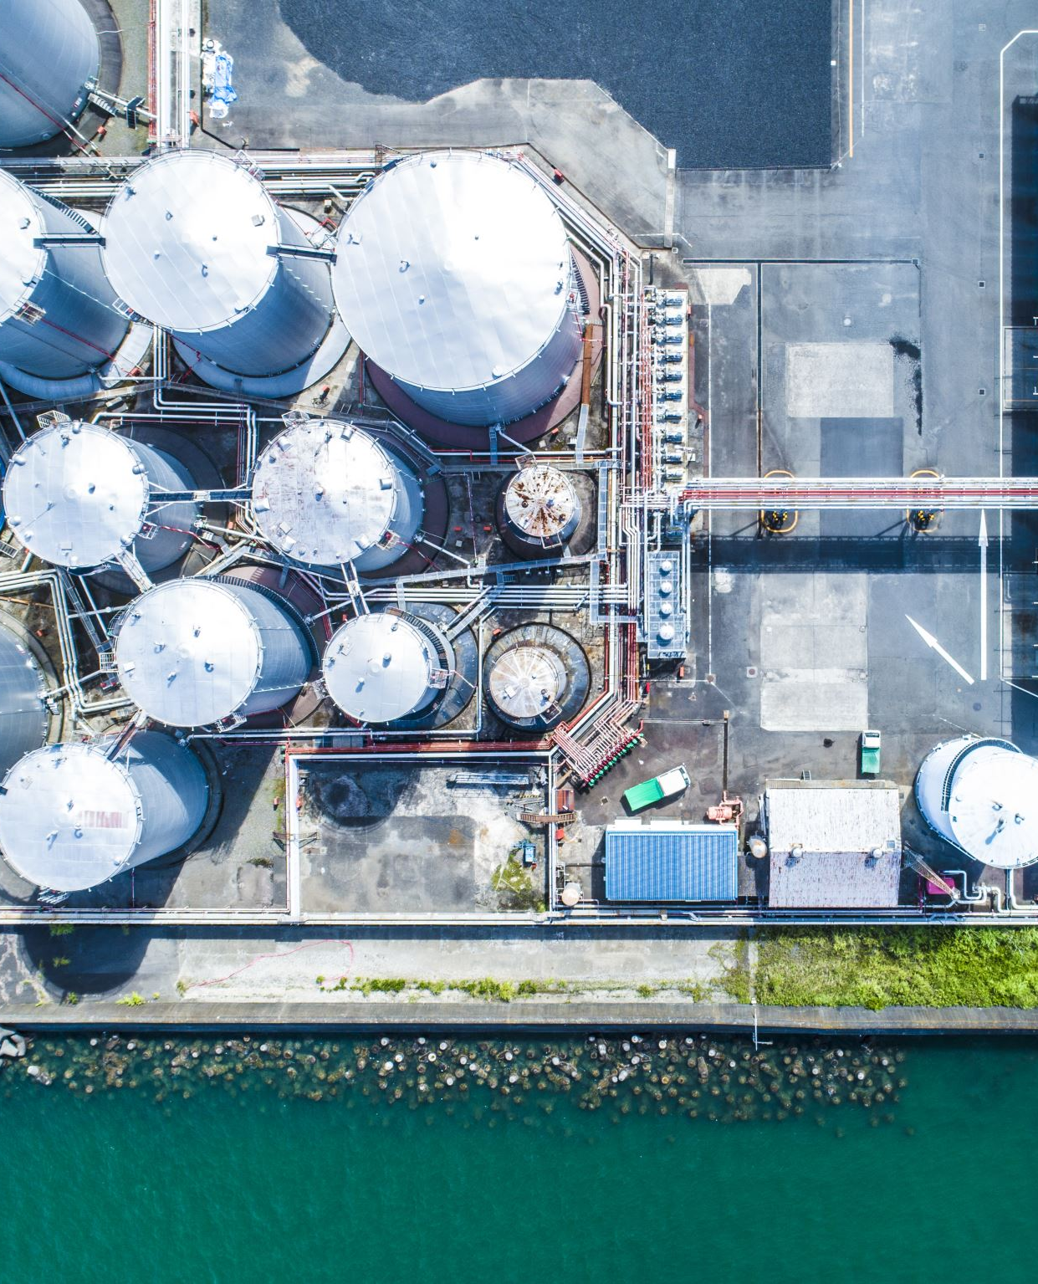
Slide 20: Petrochemical, Steel Factory Consumers and City Consumers
• Anchor loads: Freeport, Houston Ship Channel, Beaumont, Baton Rouge.
• City campuses: data centers, hospitals, universities, airports/ports.
• Steel and glass/cement co‑fire adopt clean heat from H₂.
• Contracting blends firm and flexible offtake blocks.
• PRS pressures tailored to 30–80 bar end‑use requirements. Depressure will be power-recovered by rEHC

Slide 23
H₂ Cost Estimate — Spine vs Ring (Feedline Included)
Slide 21
Kongiganak Wind + Alaska→Seattle Feedline | Color Scheme A (Blue/Gray)

Slide 24
H₂ Cost Framework
Slide 22
Levelized delivered cost at each tap
Includes electrolyzer, compression, transport, feedline
Pressure profile: 350→330 bar; API 5LX X52, 54” OD, 150 mm wall
Option B dataset (feedline included), Spine & Ring
All costs in $/kg-H₂ (HHV)

Slide 25
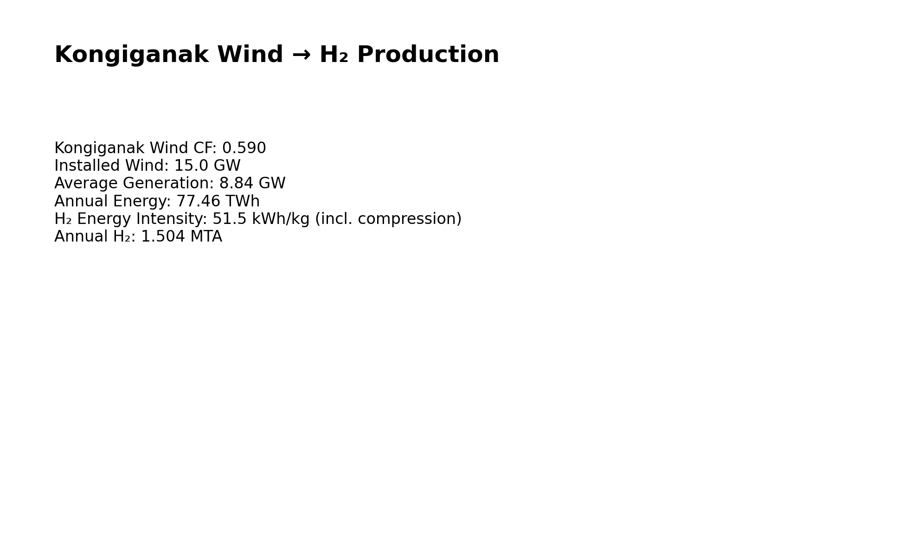
Alaska Wind-Powered Supply
Slide 23
Installed wind: 15.0 GW; CF ≈ 0.590
Avg generation: 8.84 GW; energy: 77.46 TWh/yr
H₂ energy intensity: 51.5 kWh/kg (incl. compression)
Annual H₂ ≈ 1.504 MTA (production-limited)
Surplus managed with linepack and EHC scheduling

Slide 26
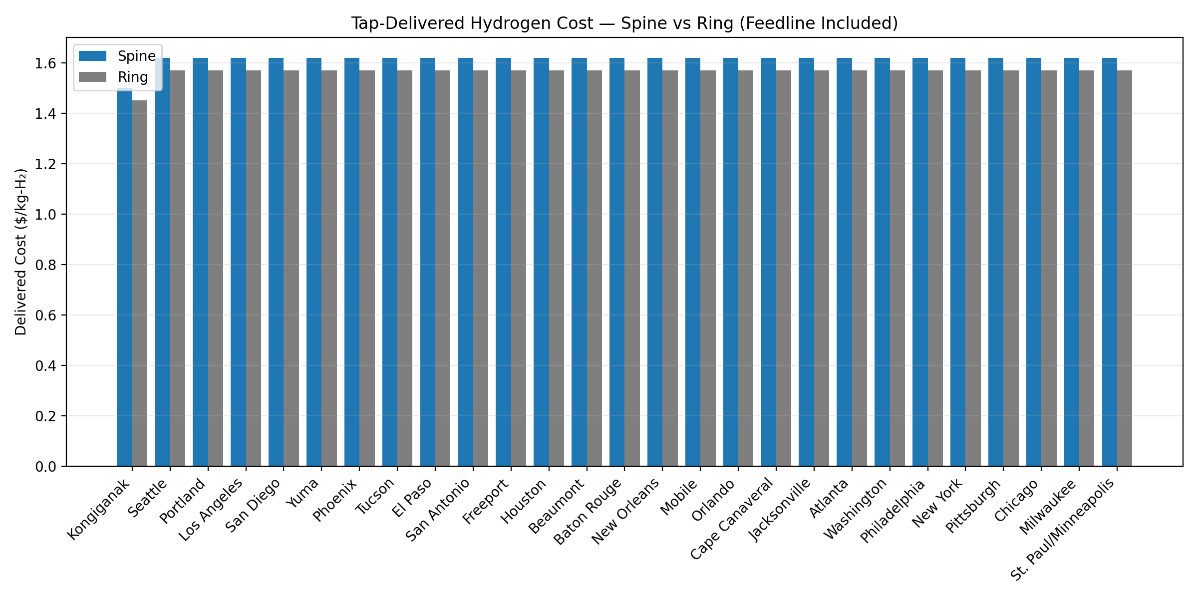
Tap-Delivered Cost — Spine vs Ring, Transport Cost Only
Slide 24
Ring consistently lower $/kg due to bidirectional hydraulics
Spine shows slightly higher ΔP staging impacts
Feedline cost assigned to all taps except origin
Warm-up/RH adder negligible at tap scale
Uniform color scheme A (Blue/Gray)

Slide 27
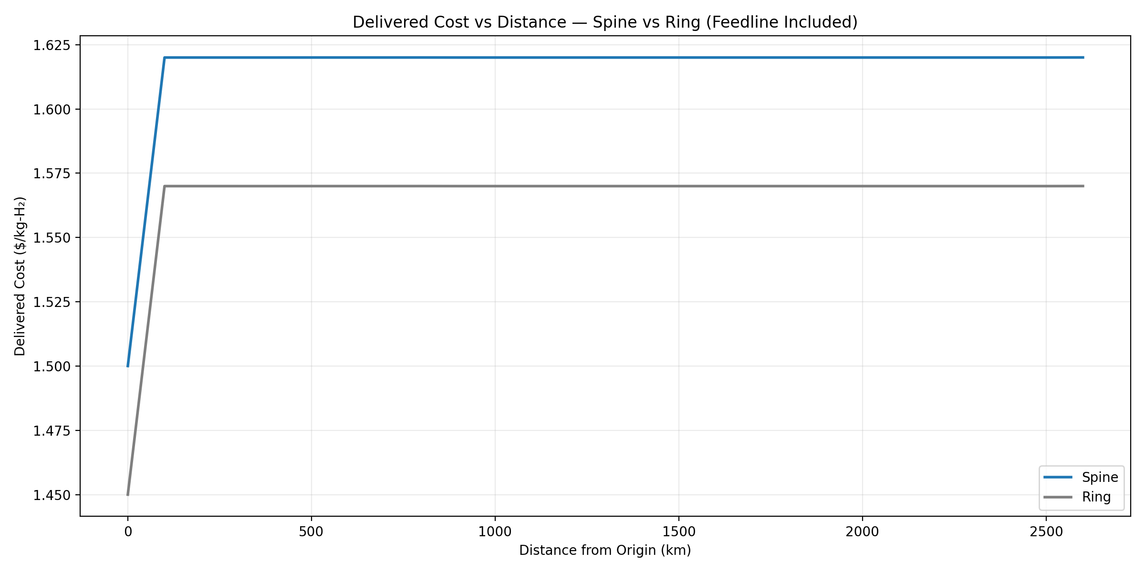
Cost vs Distance — Spine vs Ring
Slide 25
Distance based on Alaska→Seattle + corridor route
Spine and Ring plotted over identical taps
Ring reduces compression peaks and losses
Spine higher at congested nodes; Ring smooths profile
Consistent order and labeling for reproducibility

Slide 28
Sensitivity/Notes
Slide 26
Wind CF ±0.05 → ±$0.08/kg; $/kWh ±0.04 → ±$0.10/kg
Demand distribution shifts → ±$0.03/kg
MAOP margin ±20 bar → <±$0.02/kg
Ring remains lower in all tested scenarios
RH/warm-up cost adder < $0.00003/kg (negligible)

Slide 29
Slide 27
H₂ Corridor —
Transport vs Full LCOH (0.07 $/kWh Wind Base)

Slide 30
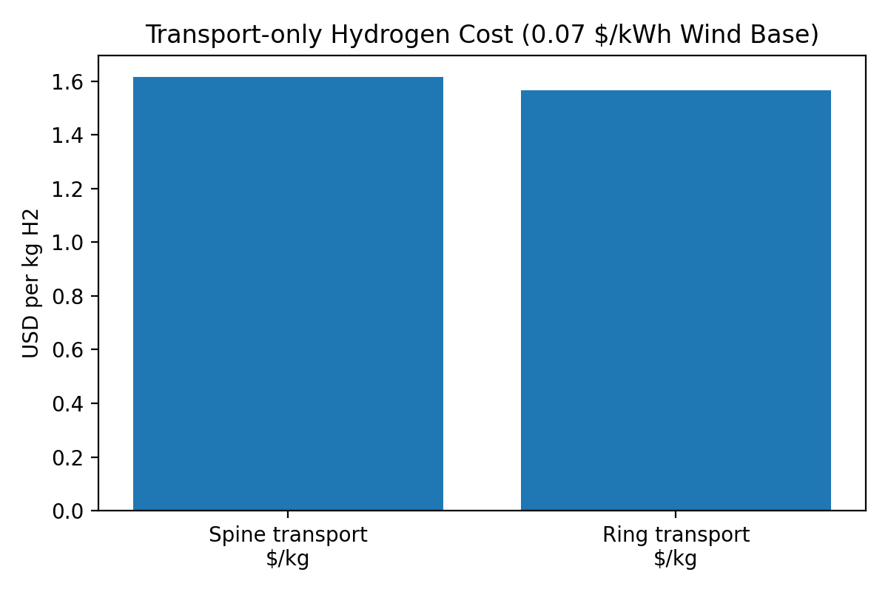
Slide 28 — Transport-only Cost (Spine vs Ring)
Notes:
Transport-only cost excludes production (PEM) and plant-gate compression. Values sourced from Tap_Costs workbook.

Slide 31
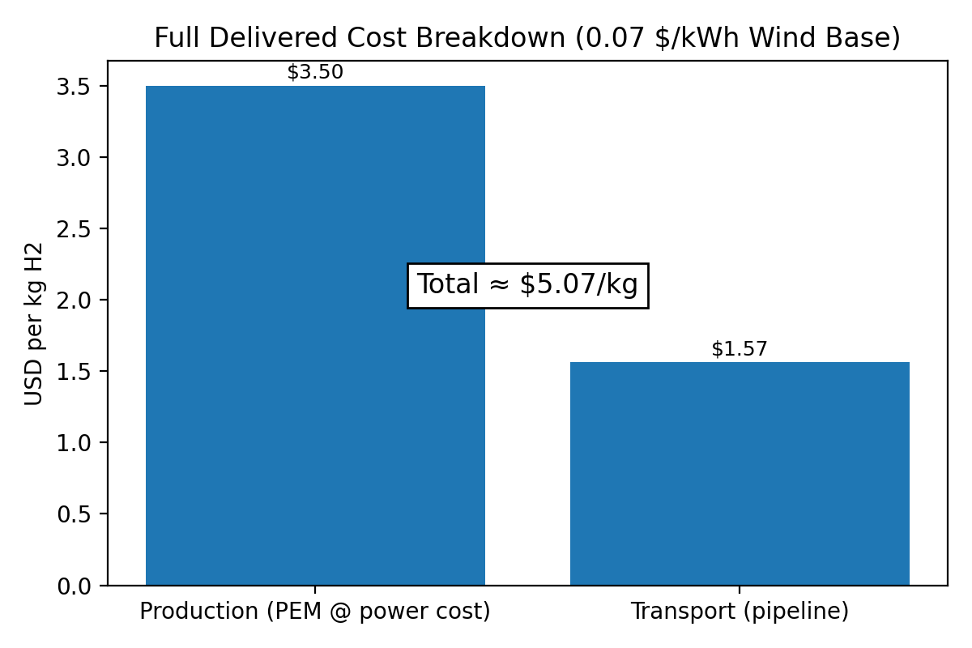
Slide 29 — Full Delivered Cost Breakdown
Assumptions: 50 kWh/kg H₂, electricity 0.07 $/kWh.
If Delivered column not present, computed as Plant-gate + Transport.

Slide 32
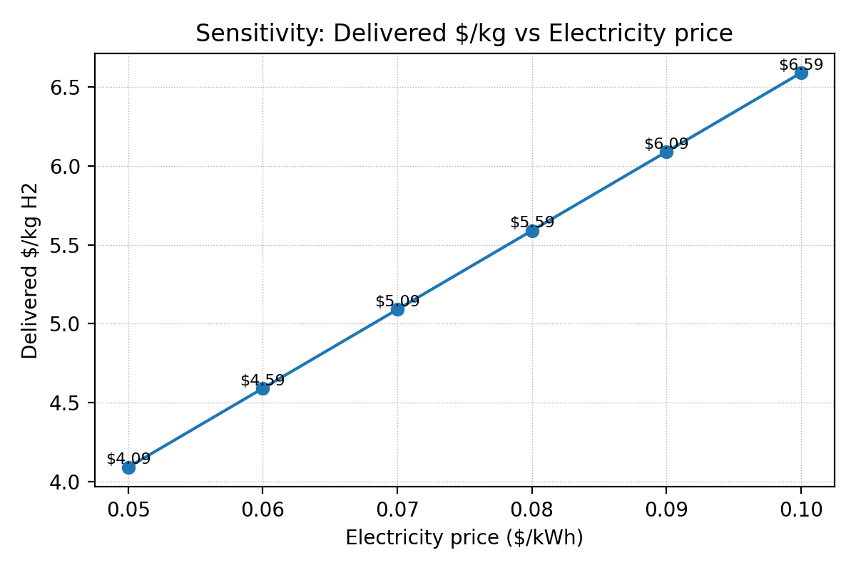
Slide 30 — Sensitivity to Electricity Price
Notes:
Simple model: Delivered = Transport_mean + (kWh/kg * $/kWh). Transport_mean from Spine/Ring averages.

Slide 33
Slide 31 — Executive Takeaways
• Transport-only cost is ~1.5 $/kg (Spine/Ring), clearly below LH₂/LOHC logistics at scale.
• Full delivered green H₂ ~3 $/kg at $0.07/kWh and ~50 kWh/kg PEM — competitive with U.S. blue H₂ ranges.
• Ring slightly reduces delivered $/kg via flow balancing, at higher CAPEX/OPEX vs Spine.
• Key drivers: $/kWh, CF, PEM efficiency; multi-hub supply smooths electrolyzer utilization.
• With $0.05/kWh and 65% CF, delivered cost approaches low-$2/kg territory.

Slide 34
Final Slide: Global Impact and Reaching 280ppm, Preindustrial Age
• Backbone infrastructure accelerates economy‑wide fuel switching.
• Enables deep cuts in CO₂ across sectors and regions.
• Scalable template for additional U.S. and global corridors.
• Supports resilience during grid stress and disasters.
• Strategic aim: durable pathway toward ~280 ppm CO₂e, as pre-industrial age
Slide 32

Slide 35
Appendix
: Pipeline pressure drop calculation by ChemCad

Slide 36
Pipeline Scheme Typical, 350km

Slide 37
ChemCad Output: Pipeline Information
Pipe / Line Sizing Summary
Equip. No. | 1
Name
Method | 2
Diameter m | 1.071
Calculated ID m | 1.071
Wall thickness m | 0.15
Pipe length m | 350000 | Output press. bar | 345.3262
Roughness factor m | 4.57E-05 | DP/100ft, psi | 0.0059
Pressure drop bar | 4.6738 | Gas flow kg/s | 70.95
Reynolds # vap | 8.44E+06 | Gas density kg/m3 | 23.2464
Fric factr vap | 0.0107 | Gas viscosity N-s/m2 | 1.00E-05
Avg density kg/m3 | 23.2464 | Total ELength m | 350000
Calc. velocity m/sec | 3.3879 | No of segments | 10
DP friction bar | 4.6738 | Friction fac. model | 1

Slide 38
ChemCad Output: Stream Information
STREAM PROPERTIES
Stream No. | 1 | 2
Name
- - Overall - -
Molar flow kmol/s | 35.1969 | 35.1969
Mass flow kg/s | 70.95 | 70.95
Temp C | 25 | 25.195
Pres bar | 350 | 345.3262
Vapor mole fraction | 1 | 1
Enth MJ/s | 11.159 | 11.159
Tc C | -239.88 | -239.88
Pc bar | 12.9595 | 12.9595
Std. sp gr. wtr = 1 | 0.07 | 0.07
Std. sp gr. air = 1 | 0.07 | 0.07
Degree API | 1889.928 | 1889.928
Average mol wt | 2.0158 | 2.0158
Actual dens kg/m3 | 23.3647 | 23.101
Actual vol m3/h | 10931.88 | 11056.64
Std liq m3/h | 3648.862 | 3648.862
Std vap 0 C m3/h | 2840011 | 2840011

